Slide 1
Chapter 16 – Project
Management
Operations Management
by
R. Dan Reid & Nada R. Sanders
3th Edition © Wiley 2010
PowerPoint Presentation by R.B. Clough – UNH
M. E. Henrie - UAA
© Wiley 2010

Slide 2
Project Management Applications
What is a project?
  Any unique endeavor with specific objectives
  With multiple activities
  With defined precedent relationships
  With a specific time period for completion
  It is one of the process selection choices in Ch 3
Examples?
  A major event like a wedding
  Any construction project
  Designing a political campaign
© Wiley 2010

Slide 3
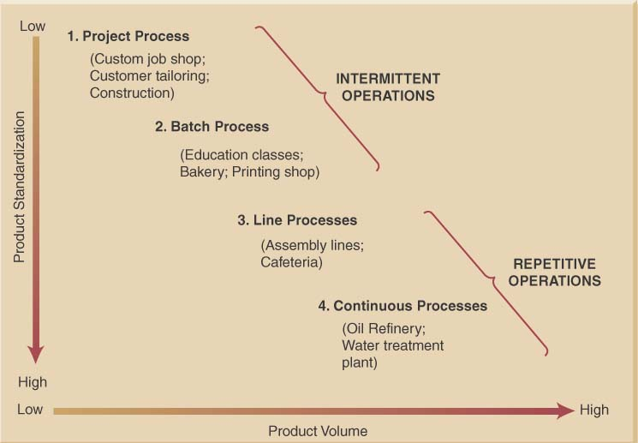
Underlying Process Relationship Between Volume and Standardization Continuum
© Wiley 2010

Slide 4
Project Life Cycle
Conception: identify the need
Feasibility analysis or study: costs benefits, and risks
Planning: who, how long, what to do?
Execution: doing the project
Termination: ending the project
© Wiley 2010

Slide 5
Network Planning Techniques
Program Evaluation & Review Technique (PERT):
  Developed to manage the Polaris missile project
  Many tasks pushed the boundaries of science & engineering (tasks’ duration = probabilistic)
Critical Path Method (CPM):
  Developed to coordinate maintenance projects in the chemical industry
  A complex undertaking, but individual tasks are routine (tasks’ duration = deterministic)
© Wiley 2010

Slide 6
Both PERT and CPM
Graphically display the precedence relationships & sequence of activities
Estimate the project’s duration
Identify critical activities that cannot be delayed without delaying the project
Estimate the amount of slack associated with non-critical activities
© Wiley 2010

Slide 7
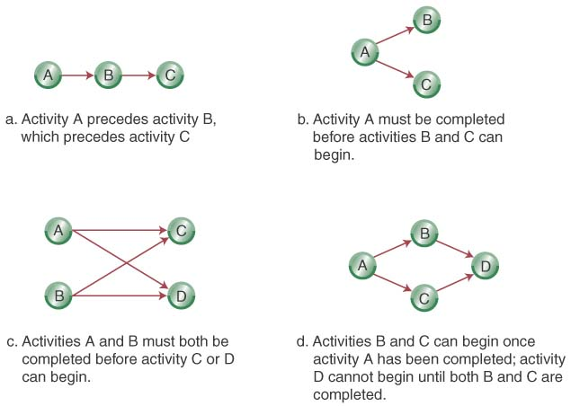
Network Diagrams
Activity-on-Node (AON):
  Uses nodes to represent the activity
  Uses arrows to represent precedence relationships
© Wiley 2010

Slide 8
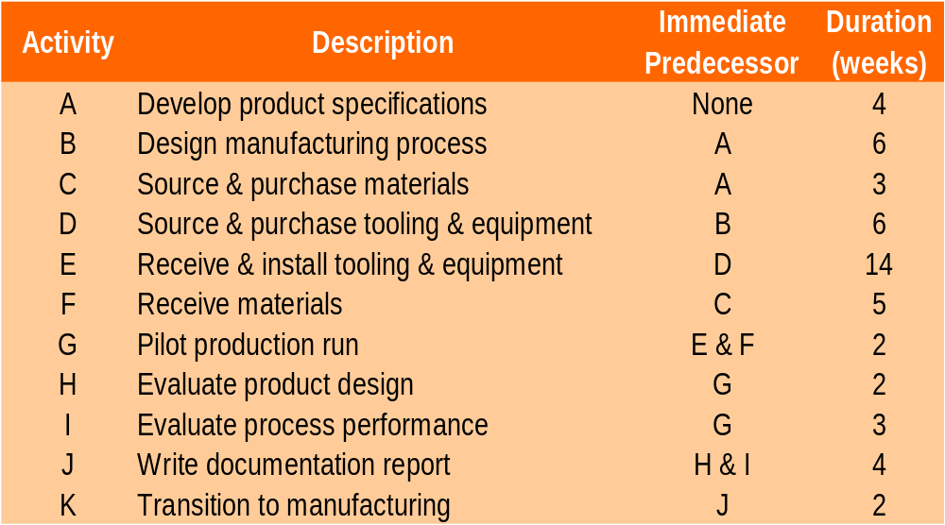
Step 1-Define the Project: Cables By Us is bringing a new product on line to be manufactured in their current facility in some existing space. The owners have identified 11 activities and their precedence relationships. Develop an AON for the project.
© Wiley 2010

Slide 9
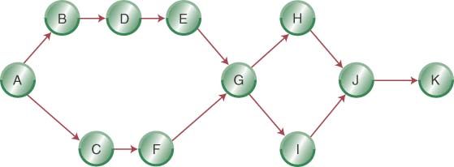
Step 2- Diagram the Network for
Cables By Us
© Wiley 2010

Slide 10
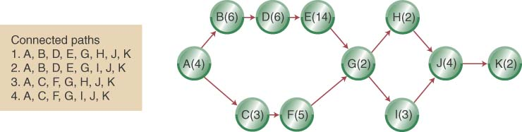
Step 3 (a)- Add Deterministic Time Estimates and Connected Paths
© Wiley 2010

Slide 11
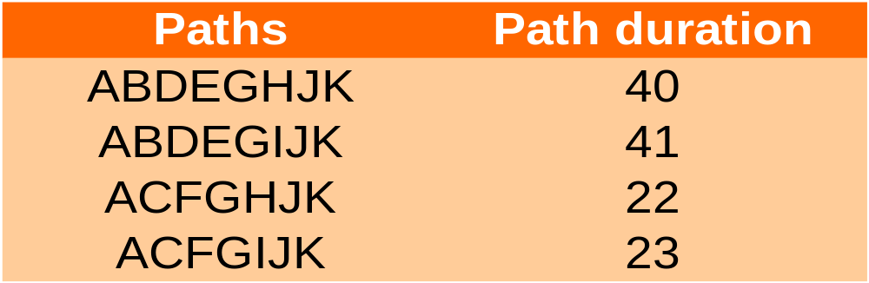
Step 3 (a) (Continued): Calculate the Path Completion Times
The longest path (ABDEGIJK) limits the project’s duration (project cannot finish in less time than its longest path)
ABDEGIJK is the project’s critical path
© Wiley 2010

Slide 12
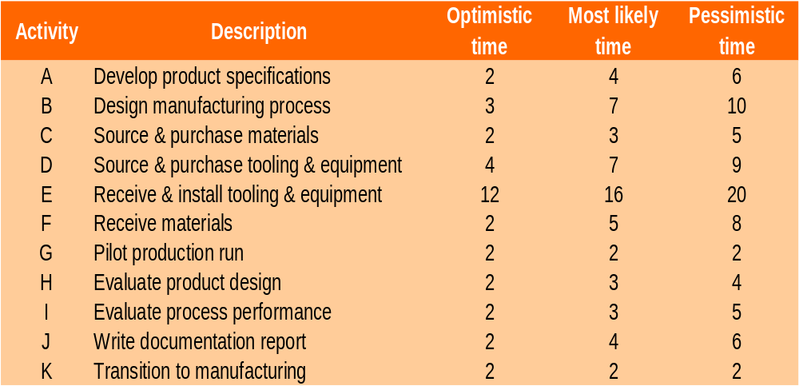
Revisiting Cables By Us Using Probabilistic Time Estimates
© Wiley 2010

Slide 13
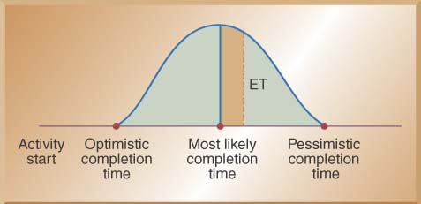

Using Beta Probability Distribution to Calculate Expected Time Durations
A typical beta distribution is shown below, note that it has definite end points
The expected time for finishing each activity is a weighted average
© Wiley 2010

Slide 14
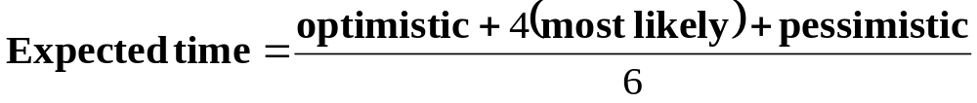
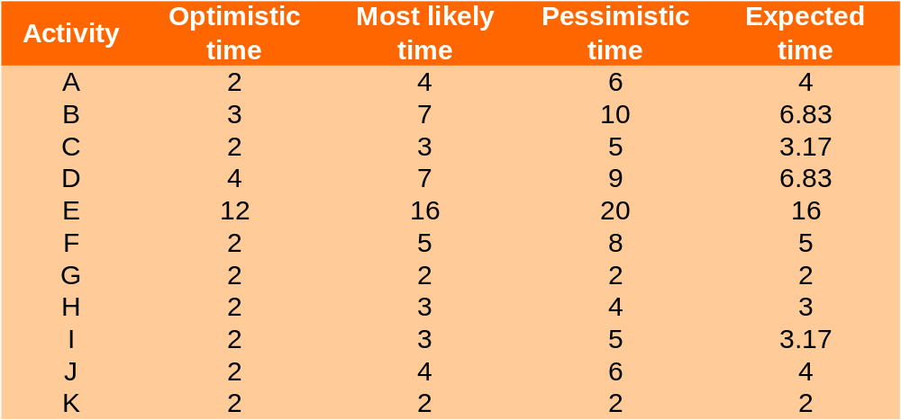
Calculating Expected Task Times
© Wiley 2010

Slide 15
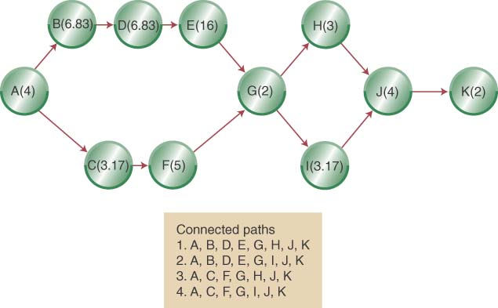
Network Diagram with Expected Activity Times
© Wiley 2010

Slide 16
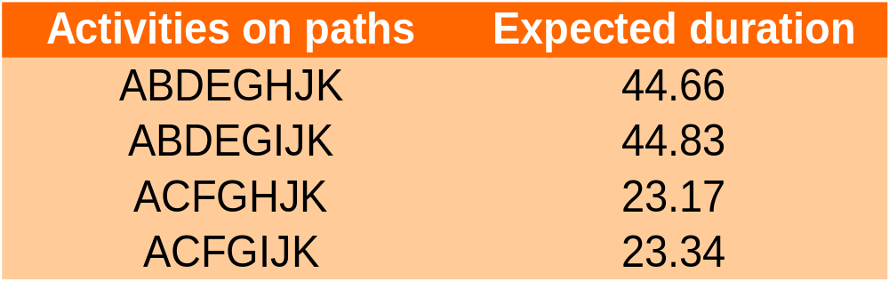
Estimated Path Durations through the Network
ABDEGIJK is the expected critical path & the project has an expected duration of 44.83 weeks
© Wiley 2010

Slide 17
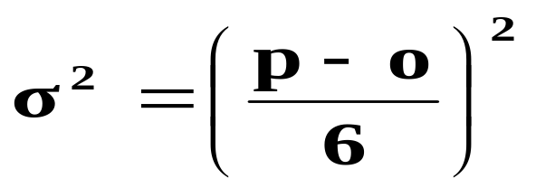
Estimating the Probability of Completion Dates
Using probabilistic time estimates offers the advantage of predicting the probability of project completion dates
We have already calculated the expected time for each activity by making three time estimates
Now we need to calculate the variance for each activity
The variance of the beta probability distribution is:
  where p=pessimistic activity time estimate
o=optimistic activity time estimate
© Wiley 2010

Slide 18
Project Activity Variances
Activity | Optimistic | Most Likely | Pessimistic | Variance
A | 2 | 4 | 6 | 0.44
B | 3 | 7 | 10 | 1.36
C | 2 | 3 | 5 | 0.25
D | 4 | 7 | 9 | 0.69
E | 12 | 16 | 20 | 1.78
F | 2 | 5 | 8 | 1.00
G | 2 | 2 | 2 | 0.00
H | 2 | 3 | 4 | 0.11
I | 2 | 3 | 5 | 0.25
J | 2 | 4 | 6 | 0.44
K | 2 | 2 | 2 | 0.00
© Wiley 2010

Slide 19
Critical Activity Variances
Activity | Optimistic | Most Likely | Pessimistic | Variance
A | 2 | 4 | 6 | 0.44
B | 3 | 7 | 10 | 1.36
C | 2 | 3 | 5 | 0.25
D | 4 | 7 | 9 | 0.69
E | 12 | 16 | 20 | 1.78
F | 2 | 5 | 8 | 1.00
G | 2 | 2 | 2 | 0.00
H | 2 | 3 | 4 | 0.11
I | 2 | 3 | 5 | 0.25
J | 2 | 4 | 6 | 0.44
K | 2 | 2 | 2 | 0.00
Critical activities highlighted
© Wiley 2010
Sum over critical = 4.96

Slide 20
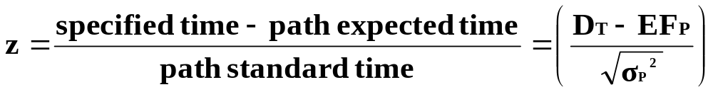

Calculating the Probability of Completing the Project in Less Than a Specified Time
When you know:
  The expected completion time EF_{P}
  Its variance σ_{Path}²
You can calculate the probability of completing the project in “D_{T}” weeks with the following formula:
Where D_{T} = the specified completion date
EFPath = the expected completion time of the path
© Wiley 2010

Slide 21
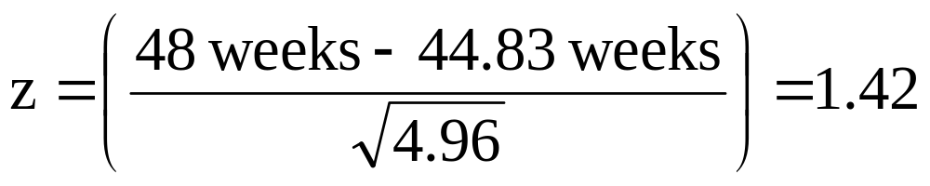
Apply z formula to critical path
Use Standard Normal Table (Appendix B) to answer probabilistic questions, such as
Question 1: What is the probability of completing project (along critical path) within 48 weeks?
© Wiley 2010

Slide 22
Probability of completion by D_{T}
Area = .4222
Probability = .4222+ .5000 =.9222 or 92.22%
Project not finished
by the given date
Tail Area = .0778
Area left of y-axis = .50
0
Z₉₂ = 1.42
z
© Wiley 2010

Slide 23
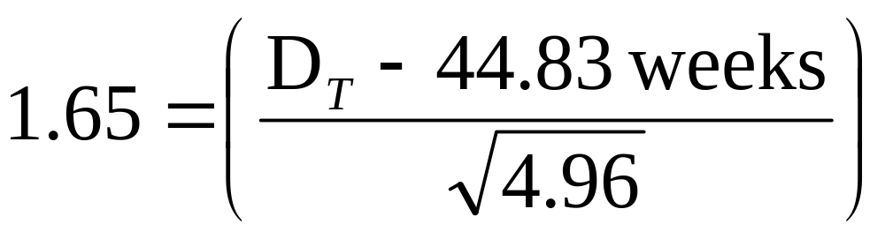
Apply z formula to critical path
Use Standard Normal Table (Appendix B) to answer probabilistic questions, such as
Question 2: By how many weeks are we 95% sure of completing project (along critical path)?
© Wiley 2010

Slide 24
Probability Question 2
Area = .45
D_{T} = 48.5 weeks
Tail Area = .05
Area left of y-axis = .50
0
Z₉₅ = 1.645
z
© Wiley 2010

Slide 25
Reducing Project Completion Time
Project completion times may need to be shortened because
  Different deadlines
  Penalty clauses
  Need to put resources on a new project
  Promised completion dates
Reduced project completion time is “crashing”
© Wiley 2010

Slide 26
Reducing Project Completion Time - continued
Crashing a project needs to balance
  Shorten a project duration
  Cost to shorten the project duration
Crashing a project requires you to know
  Crash time of each activity
  Crash cost of each activity
© Wiley 2010

Slide 27
The Critical Chain Approach
The Critical Chain Approach focuses on the project due date rather than on individual activities and the following realities:
  Project time estimates are uncertain so we add safety time
  Multi-levels of organization may add additional time to be “safe”
  Individual activity buffers may be wasted on lower-priority activities
  A better approach is to place the project safety buffer at the end
Original critical path
Activity A |  | Activity B |  | Activity C |  |  | Activity D |  | Activity E
Critical path with project buffer
Activity A | Activity B |  | Activity C |  | Activity D | Activity E |  | Project Buffer
© Wiley 2010

Slide 28
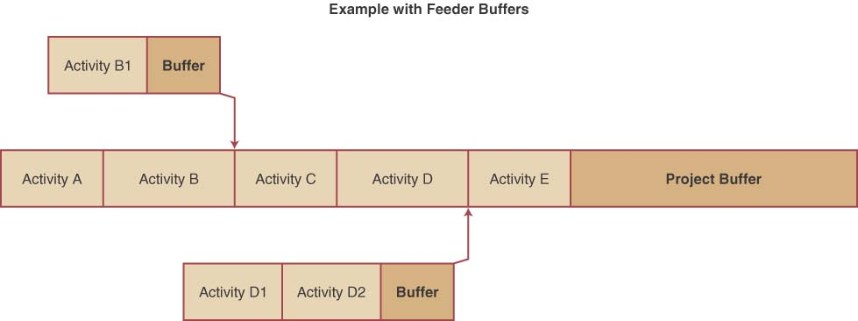
Adding Feeder Buffers to Critical Chains
The theory of constraints, the basis for critical chains, focuses on keeping bottlenecks busy.
Time buffers can be put between bottlenecks in the critical path
These feeder buffers protect the critical path from delays in non-critical paths
© Wiley 2010

Slide 29
Approaches to Project Implementation
Pure Project
Functional Project
Matrix Project
© Wiley 2010

Slide 30
Advantages
A PURE PROJECT is where a self-contained team works full-time on the project
The project manager has full authority over the project
Team members report to one boss
Shortened communication lines
Team pride, motivation, and commitment are high
Source: Chase, Jacobs & Aquilano, Operations Management 11/e
Notes:
8

Slide 31
Pure Project: Disadvantages
Duplication of resources
Organizational goals and policies are ignored
Lack of technology transfer
Team members have no functional area "home"
Source: Chase, Jacobs & Aquilano, Operations Management 11/e
Notes:
8

Slide 32
Functional Project
housed within a functional division
President
Research and
Development
Engineering
Manufacturing
Project
A
Project
B
Project
C
Project
D
Project
E
Project
F
Project
G
Project
H
Project
I
Example, Project “B” is in the functional area of Research and Development.
Source: Chase, Jacobs & Aquilano, Operations Management 11/e
Notes:
9

Slide 33
Functional Project: Advantages
A team member can work on several projects
Technical expertise is maintained within the functional area
The functional area is a “home” after the project is completed
Critical mass of specialized knowledge
Source: Chase, Jacobs & Aquilano, Operations Management 11/e
Notes:
10

Slide 34
Functional Project: Disadvantages
Aspects of the project that are not directly related to the functional area get short-changed
Motivation of team members is often weak
Needs of the client are secondary and are responded to slowly
Source: Chase, Jacobs & Aquilano, Operations Management 11/e
Notes:
11

Slide 35
Matrix Project: combines features of pure and functional
President
Research and
Development
Engineering
Manufacturing
Marketing
Manager
Project A
Manager
Project B
Manager
Project C
Source: Chase, Jacobs & Aquilano, Operations Management 11/e
Notes:
12

Slide 36
Matrix Project: Advantages
Enhanced communications between functional areas
Pinpointed responsibility
Duplication of resources is minimized
Functional “home” for team members
Policies of the parent organization are followed
Source: Chase, Jacobs & Aquilano, Operations Management 11/e
Notes:
13

Slide 37
Matrix Project: Disadvantages
Too many bosses
Depends on project manager’s negotiating skills
Potential for sub-optimization
Source: Chase, Jacobs & Aquilano, Operations Management 11/e
Notes:
14

Slide 38
Project Management OM Across the Organization
Accounting uses project management (PM) information to provide a time line for major expenditures
Marketing use PM information to monitor the progress to provide updates to the customer
Information systems develop and maintain software that supports projects
Operations use PM to information to monitor activity progress both on and off critical path to manage resource requirements
© Wiley 2010

Slide 39
Chapter 16 Highlights
A project is a unique, one time event of some duration that consumes resources and is designed to achieve an objective in a given time period.
Each project goes through a five-phase life cycle: concept, feasibility study, planning, execution, and termination.
Two network planning techniques are PERT and CPM. Pert uses probabilistic time estimates. CPM uses deterministic time estimates.
Pert and CPM determine the critical path of the project and the estimated completion time. On large projects, software programs are available to identify the critical path.
© Wiley 2010

Slide 40
Chapter 16 Highlights (continued)
Pert uses probabilistic time estimates to determine the probability that a project will be done by a specific time.
To reduce the length of the project (crashing), we need to know the critical path of the project and the cost of reducing individual activity times. Crashing activities that are not on the critical path typically does not reduce project completion time.
The critical chain approach removes excess safety time from individual activities and creates a project buffer at the end of the critical path.
© Wiley 2010

Slide 41
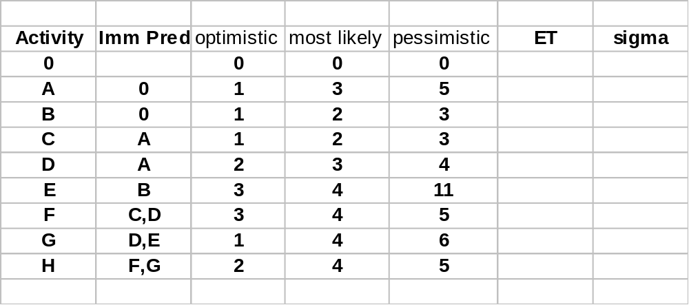
Additional Example
Note: activity “0” is a formality.
© Wiley 2010
Source: Chase, Jacobs & Aquilano, Operations Management 11/e

Slide 42
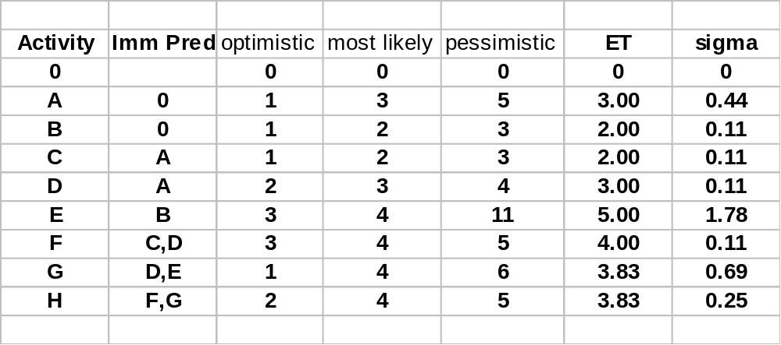
Additional Example
Note: activity “0” is a formality.
© Wiley 2010
Source: Chase, Jacobs & Aquilano, Operations Management 11/e

Slide 43
Additional Example, continued
C
A
2
F
3
4
D
0
H
3
3.83
paths
0ACFH
0ADFH
0ADGH
0BEGH
G
B
2
3.83
E
5
© Wiley 2010

Slide 44
Additional Example, continued
C
A
2
F
3
4
D
0
H
3
3.83
G
B
2
3.83
E
Critical Path: 0-B-E-G-H
Length = 14.67
5
© Wiley 2010

Slide 45
Additional Example, continued.
Add variances along path
to get path variance
C
1.83
F
A
.83
.83
D
0
H
.83
0.25
0.11
0
1.78
G
B
0.69
0
0
total=2.83
E
0
© Wiley 2010

Slide 46
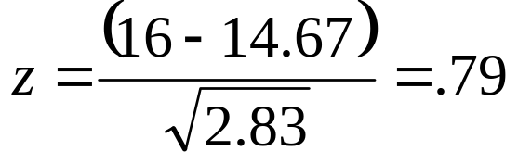
Probabilistic Analysis
Additional Example, continued.
Project completion times assumed normally distributed with mean 14.67 and variance 2.83
Z-score
From table look-up, P(D_{T}≤16) = .7549
14.67
16
Find the probability of completing the project within 16 days.
© Wiley 2010

Slide 47
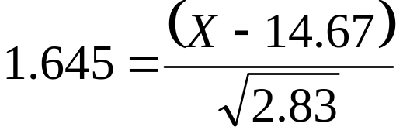
Probabilistic Analysis
Additional Example, continued.
Project completion times assumed normally distributed with mean 14.67 and variance 2.83
Z₉₅ = 1.645, thus
Solving for X=17.44 days
14.67
17.44
Find the 95-th percentile of project completion.
© Wiley 2010

Slide 48
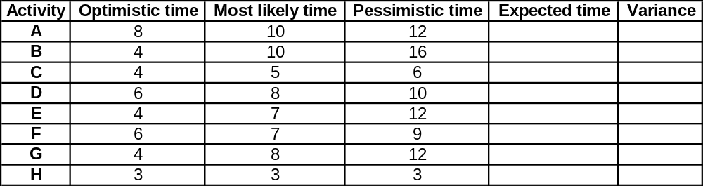
Example 2, #13-14 Ch 16:
© Wiley 2010

Slide 49
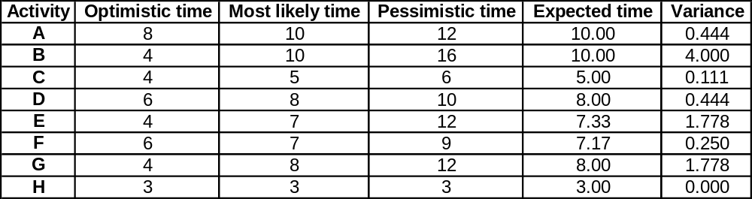
Example 2, #13-14 Ch 16:
© Wiley 2010

Slide 50
Example 2, #13-14 Ch 16:
B(10)
D(8)
F(7.17)
A(10)
H(3)
C(5)
E(7.33)
G(8)
© Wiley 2010

Slide 51
Example 2, #13-14 Ch 16: PATH 1
B(10)
D(8)
F(7.17)
A(10)
H(3)
Length = 38.17
© Wiley 2010

Slide 52
Example 2, #13-14 Ch 16: PATH 2
Length = 33.33
A(10)
H(3)
C(5)
E(7.33)
G(8)
© Wiley 2010

Slide 53
Example 2, #13-14 Ch 16: PATH 3
B(10)
D(8)
A(10)
H(3)
Length = 39
G(8)
© Wiley 2010

Slide 54
Example 2, #13-14 Ch 16: PATH 4
F(7.17)
Length = 32.5
A(10)
H(3)
C(5)
E(7.33)
© Wiley 2010

Slide 55
Example 2, #13-14 Ch 16: CRITICAL PATH
B(10)
D(8)
A(10)
H(3)
Length = 39
Path variance = 6.67
G(8)
© Wiley 2010

Slide 56
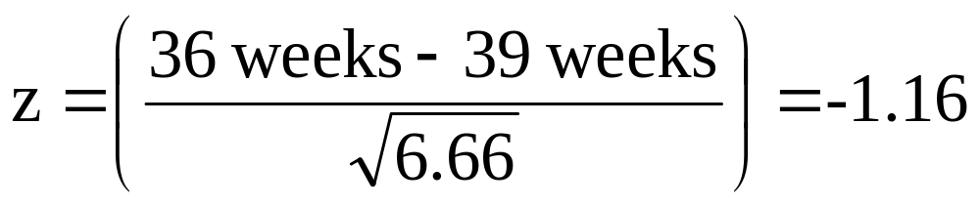
Apply z formula to critical path
Use Standard Normal Table (Appendix B) to answer probabilistic questions, such as
Question 1: What is the probability of completing project (along critical path) within 36 weeks?
© Wiley 2010

Slide 57
Probability of completion by D_{T}
Area left of y-axis = .50
Area = .3770
Probability =
.5000 - 3770
=.1230 or 12.3%
Project finished
by the given date
Tail Area = .1230
0
z
Z = -1.16
© Wiley 2010

Slide 58
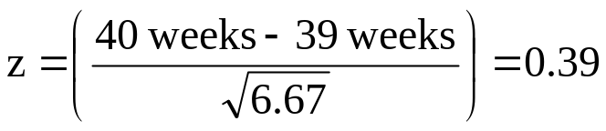
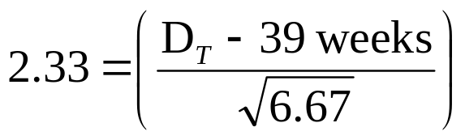
Apply z formula to critical path
Use Standard Normal Table (Appendix B) to answer probabilistic questions, such as
Question 2: What is the probability of completing project (along critical path) within 40 weeks?
Probability = .6517 = 65.17%
Question 3: By how many weeks are we 99% sure of completing project (along critical path)?
DT = 45.02 weeks
© Wiley 2010

Slide 59
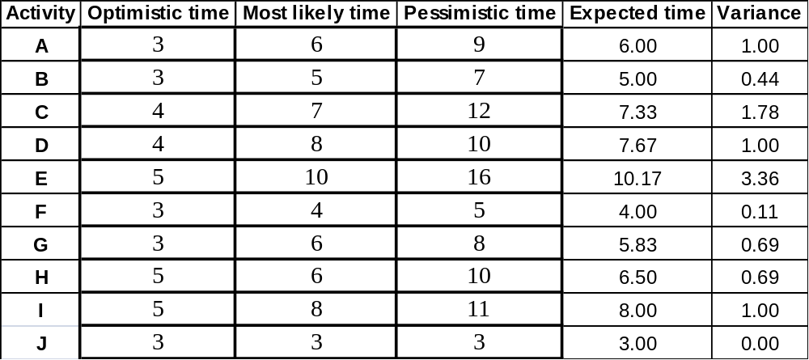
Example 3, #4-8 Ch 16:
© Wiley 2010

Slide 60
Example 3, #4-#8 Ch 16:
B(5)
D(7.67)
F(4)
H(6.5)
A(6)
J(3)
C(7.33)
G(5.83)
I(8)
E(10.17)
© Wiley 2010

Slide 61
Example 3, #4-#8 Ch 16:
B(5)
D(7.67)
F(4)
H(6.5)
A(6)
J(3)
C(7.33)
G(5.83)
I(8)
E(10.17)
length =32.17
© Wiley 2010

Slide 62
Example 3, #4-#8 Ch 16:
B(5)
D(7.67)
F(4)
H(6.5)
A(6)
J(3)
C(7.33)
G(5.83)
I(8)
E(10.17)
length = 35.50
© Wiley 2010

Slide 63
Example 3, #4-#8 Ch 16:
B(5)
D(7.67)
F(4)
H(6.5)
A(6)
J(3)
C(7.33)
G(5.83)
I(8)
E(10.17)
length =37
© Wiley 2010

Slide 64
Example 3, #4-#8 Ch 16:
B(5)
D(7.67)
F(4)
H(6.5)
A(6)
J(3)
C(7.33)
G(5.83)
I(8)
E(10.17)
length = 40.33 CRITICAL PATH
© Wiley 2010

Slide 65
Example 3, #4-#8 Ch 16:
B(5)
D(7.67)
F(4)
H(6.5)
A(6)
J(3)
C(7.33)
G(5.83)
I(8)
E(10.17)
Path variance =1+1.78+3.36+0.69+1+0 = 7.83
© Wiley 2010

Slide 66
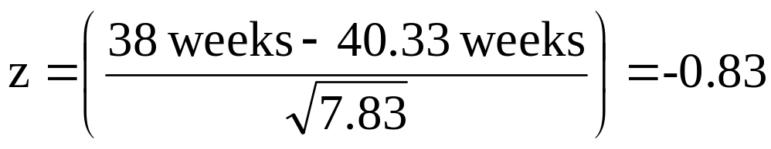
Apply z formula to critical path
Use Standard Normal Table (Appendix B) to answer probabilistic questions, such as
Question 1: What is the probability of completing project (along critical path) within 38 weeks?
© Wiley 2010

Slide 67
Probability of completion by D_{T}=38
Area left of y-axis = .50
Area = .2967
Probability =
.5000 - 2967
=.2033 or 20.33%
Project finished
by the given date
Tail Area = .2033
0
z
Z = -0.83
© Wiley 2010

Slide 68
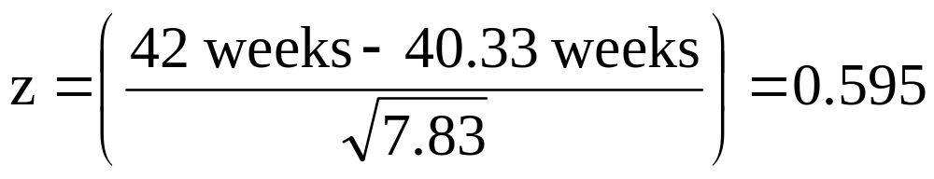
Apply z formula to critical path
Use Standard Normal Table (Appendix B) to answer probabilistic questions, such as
Question 2: What is the probability of completing project (along critical path) within 42 weeks?
Probability = .2257+.5000 = .7257 = 72.57%
© Wiley 2010

Slide 69
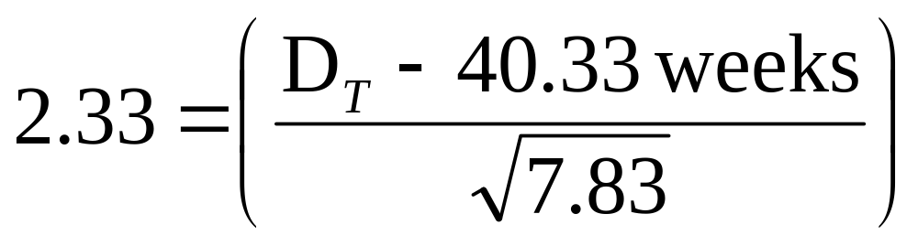
Apply z formula to critical path
Use Standard Normal Table (Appendix B) to answer probabilistic questions, such as
Question 3: By how many weeks are we 99% sure of completing project (along critical path)?
DT = 46.85 weeks
© Wiley 2010

